Slide 1
AI PRODUCTIVITY
AI Marketing Campaign Strategy: Executive Summary
Work smarter with AI. A campaign for a new AI productivity startup.

Slide 2
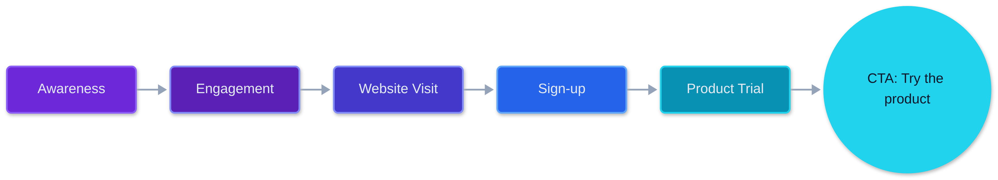
Campaign Objective
Objective: increase brand awareness and product trials. Primary CTA: Try the product.
Notes:
Walk the funnel left to right, from Awareness to Product Trial. Close on the single primary call to action: Try the product.

Slide 3




Target Audience
Founders and startup teams
Challenge: need efficient workflows. Outcome: streamlined, faster execution.
Students
Challenge: need better research and study planning. Outcome: organized, confident study.
Content creators
Challenge: need fresh ideas and organized content. Outcome: a steady creative flow.
Professionals
Challenge: want to improve productivity. Outcome: more done with less effort.

Slide 4





Core Message: Work smarter with AI
Product demonstrations
AI tips and tutorials
Real-world use cases
Productivity workflows
User stories and results
Notes:
Land the message: work smarter with AI. Walk through the five pillars that carry it across every channel.

Slide 5
Four-Week Action Plan
Week 1
Week 2
Week 3
Week 4
1
2
3
4
Introduce the product and its key features
Publish practical demonstrations and tutorials
Share use cases and workflow examples
Publish a campaign recap and encourage product trials
Notes:
Walk the four weeks left to right: introduce, demonstrate, show use cases, then recap and drive trials.

Slide 6
Content Formats
Format | Style | Hook | CTA
LinkedIn posts | Text post | Opens the post | Closes the post
X posts | Short post | Opens the post | Closes the post
Short product demo videos | Short video | Opens the first seconds | Closes the video
Educational carousels | Carousel | Opens the first slide | Closes the last slide
Before-and-after workflow demos | Side-by-side demo | Opens on the before state | Closes on the after state
Every format pairs a hook, a format style and a CTA.

Slide 7




Key Metrics to Monitor
Reach and impressions
Target to be agreed before launch
Engagement rate
Target to be agreed before launch
Website visits
Target to be agreed before launch
Sign-ups and product trials
Target to be agreed before launch

Slide 8
Immediate Next Steps
Step 1
Confirm the target values for each KPI
Step 2
Finalize the Week 1 content calendar and assets
Step 3
Produce the first short demo video and carousel
Step 4
Set up tracking for visits, sign-ups and trials
Step 5
Assign owners per channel and schedule a weekly review

